Slide 1
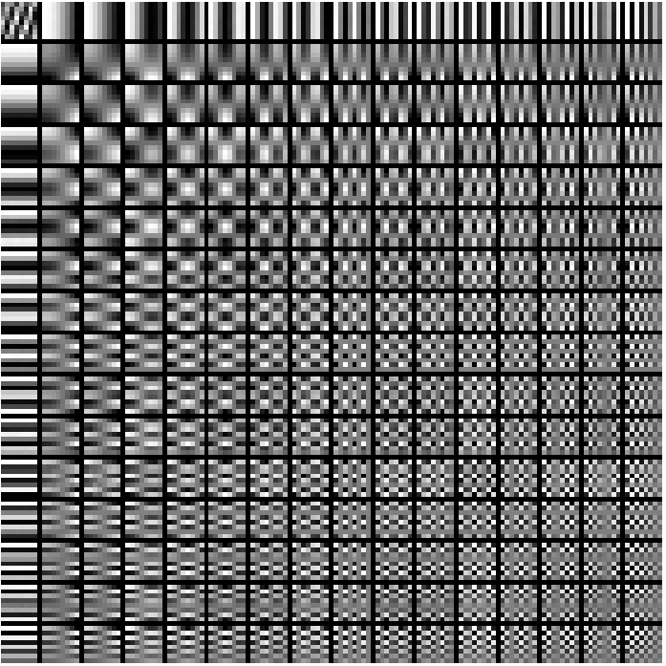
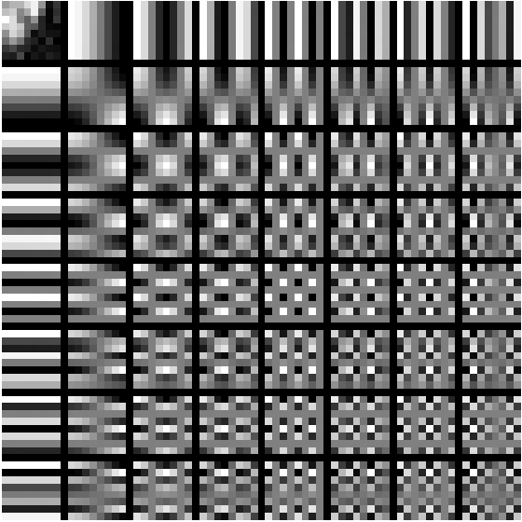
Advanced Machine Learning

Slide 2
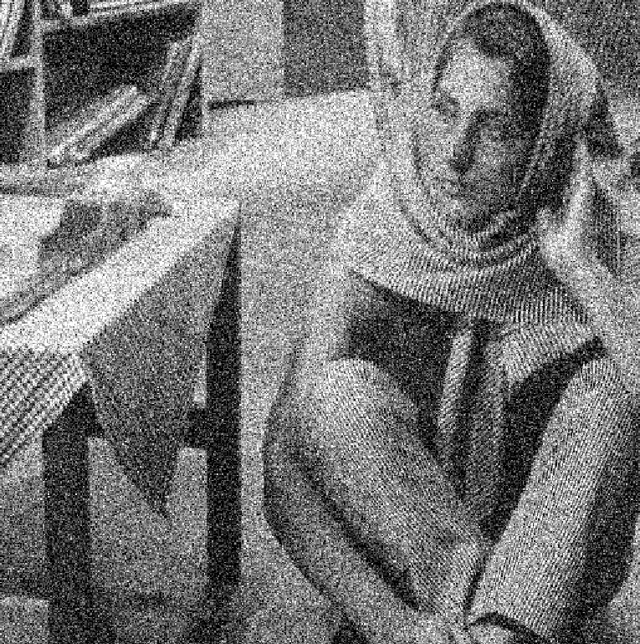

Slide 3
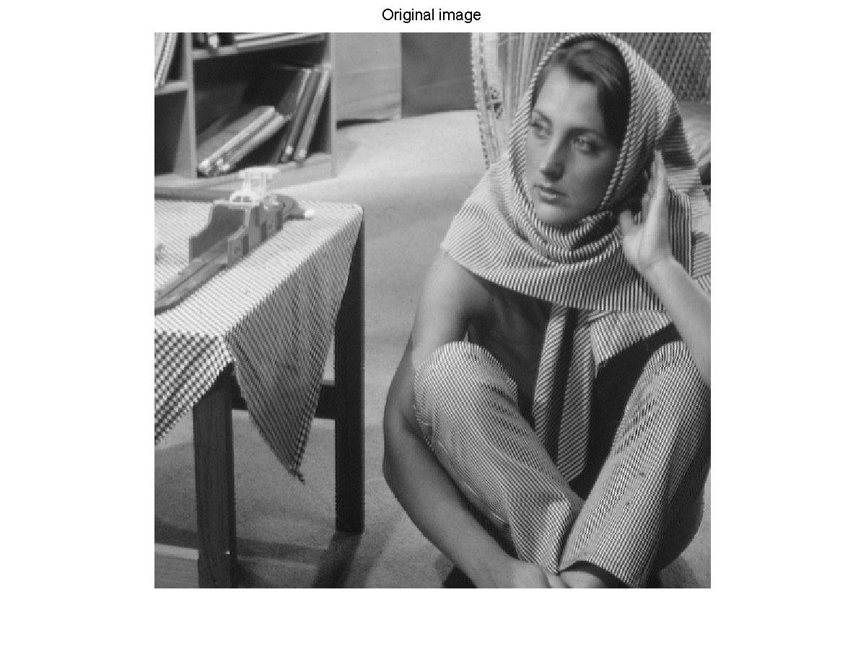

Slide 5

$$x_{1}$$
$$0$$
$$0$$
0
$$x_{5}$$
0
$$x_{7}$$
0
=
+
+

Slide 6
Sparse Coding Techniques for Dictionary Learning in Context of Image De-noising
Sarah Panda (sp3206)
Dhaivat Shah (ds3267)
Gaurav Ahuja (ga2371)

Slide 7
What is a Dictionary?
A dictionary, D is an N X k matrix that contains k prototype signals called ATOMS as columns, such that any given signal y can be represented as a linear combination of a small number of these atoms.
Each of the atoms in the dictionary is a vector of length N which in itself is a potential signal.
For any signal y and dictionary D, there must exist a vector x in R_k, such that,
y = Dx
,where x contains the representation coefficients of signal y.

Slide 8
What is a Dictionary?
A dictionary, D is an N X k matrix that contains k prototype signals called ATOMS as columns, such that any given signal y can be represented as a linear combination of a small number of these atoms.
Each of the atoms in the dictionary is a vector of length N which in itself is a potential signal.
For any signal y and dictionary D, there must exist a vector x in R_k, such that,
y = Dx
,where x contains the representation coefficients of signal y.

Slide 9
But, where do we get the dictionary from?
Use pre-calculated dictionaries built from a huge dataset of natural images over time.
Or,
Learn a dictionary from the given set of training signals : Has proven to dramatically improve signal reconstruction.
So, here comes the problem of Dictionary Learning!!

Slide 10
But, where do we get the dictionary from?
Use pre-calculated dictionaries built from a huge dataset of natural images over time.
Or,
Learn a dictionary from the given set of training signals : Has proven to dramatically improve signal reconstruction.
So, here comes the problem of Dictionary Learning!!

Slide 11

Dictionary Learning
Problem Statement
Classical dictionary learning techniques try to optimize the following empirical cost function, for a training set of signals Y = [y1, y2,…., yn]. [2]
$${L\left(D\right)}^{}=\frac{1}{n}\sum_{i=1}^{n}{l(y,D)}$$
l(y,D) is a loss function that assumes a low value if the dictionary D is good at representing signal y.

Slide 12

Dictionary Learning : Problem Statement
Classical dictionary learning techniques try to optimize the following empirical cost function, for a training set of signals Y = [y1, y2,…., yn]. [2]
$${L\left(D\right)}^{}=\frac{1}{n}\sum_{i=1}^{n}{l(y,D)}$$
l(y,D) is a loss function that assumes a low value if the dictionary D is good at representing signal y.

Slide 13
K-SVD
A two step iterative process to compute

Slide 14

Sparsity
The idea is to represent the signal in the terms of the dictionary and x, where x is a sparse vector.
This can be written mathematically as:
min${\left\|x\right\|}_{0}$ subject to y = Dx
Here we use the $l_{0}$ norm of x which is th number of nn-zero elements in the vector.
This is the exact representation of the problem.
But as it turns out, solving the above equation is NP-Hard.

Slide 15

Approach Used
A slightly relaxed form of the previous equation is where we do not represent y exactly but with a some error.
This leads to:
min${\left\|x\right\|}_{0}$ subject to ${\left\|y−Dx\right\|}^{2}$ < ε
But still solving this is hard.
So what do we do?
There are two approaches which can be followed from here on.

Slide 16
Greedy Approach (Matching Pursuit)

Slide 17


Basis Pursuit
The original equation can be converted to a convex form by relaxing the $l_{0}$ norm with $l_{1}$ norm.
$l\left(y,D\right)=\min{\frac{1}{2}}{\left\|y−Dx\right\|}^{2}$ + ̬λ${\left\|x\right\|}_{1}$

Slide 18
SPARSE CODING TECHNIQUES USED

Slide 19
Sparse Coding: Feature-Sign

Slide 20
Sparse Coding: FISTA

Slide 21
Sparse Coding: L1LS

Slide 22
Sparse Coding: Matching Pursuit

Slide 23
Sparse Coding: Orthogonal Matching Pursuit

Slide 24
Sparse Coding: Primal ALM

Slide 25
Sparse Coding: Dual ALM

Slide 26
RESULTS

Slide 27
CONCLUSION

Slide 28
FUTURE WORK

Slide 29
References:

